Slide 1
There is one hot jam
you can't stop singing.

Slide 5
Do you know what you are singing?

Slide 6
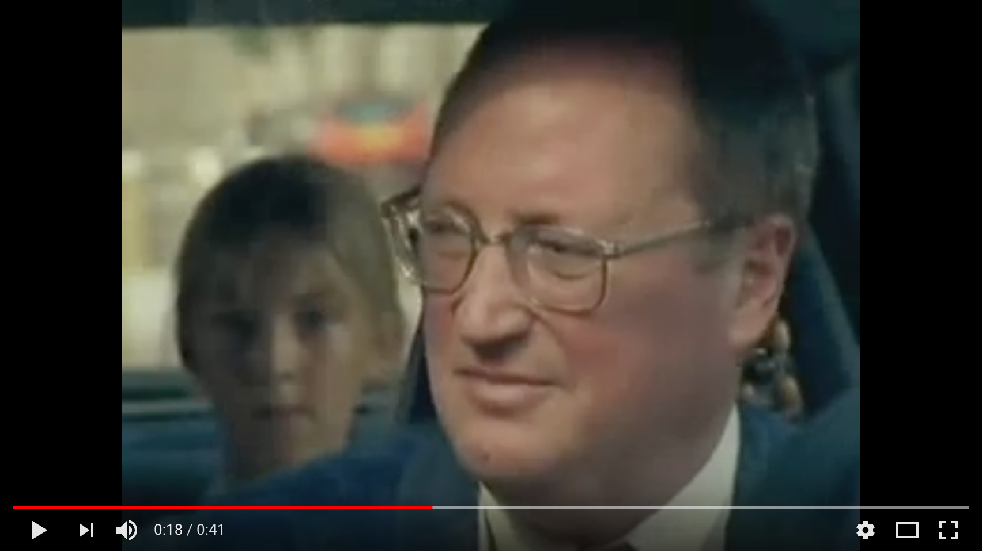

Slide 7
B-SIDE of music.

Slide 8
Sh**T IDEA

Slide 9
This is all

Slide 10
You are going to sing it anyway,
it's already stuck in your brain.

